Slide 1

Juice Laundry GOMC Analysis
Squeezed with care by: Conrad Tindall, Jarius Ang, and Bill Su

Slide 2
The Juice Laundry
1
We’re out to inspire Healthy, Organic, Powerful Change

Slide 3
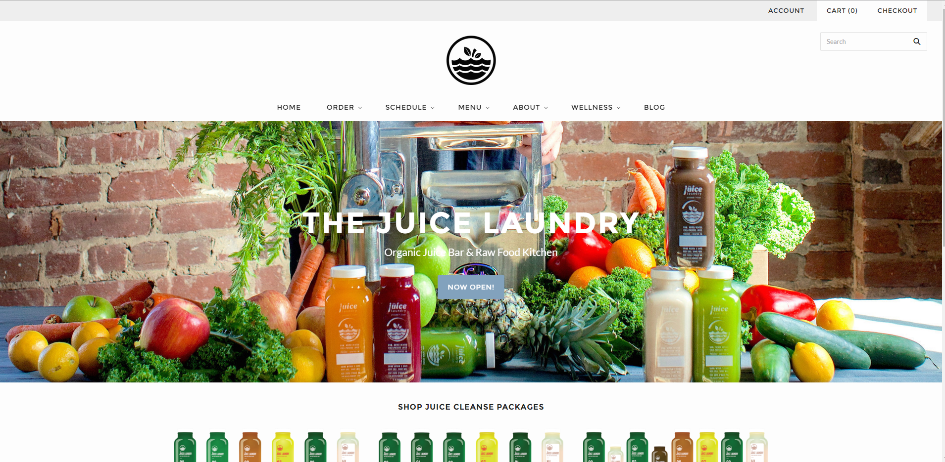
What is The Juice Laundry?
Organic cold pressed micro juicer, sold through online shopify platform and local farmer’s market.

Slide 4




Target Market
The Juice Laundry targets the Central Virginia premium juice market.
Enjoyers (20-40 years old)
Purchase juice products for meal and refreshments.
Dieters (25-60 years old)
Purchase juice cleansing packages for cleansing and dieting.
Local Competitors
National Competitors

Slide 5
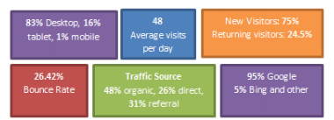


Current Marketing
The Juice Laundry uses a mix of online and offline marketing
thejuicelaundry.com
Order handling
Customer education
Customer service
Local Farmer’s Market
Word of mouth
Point of sales
Phyiscal advertising

Slide 6
GOMC Setup
2
Real money. Real results. Real experience.

Slide 7
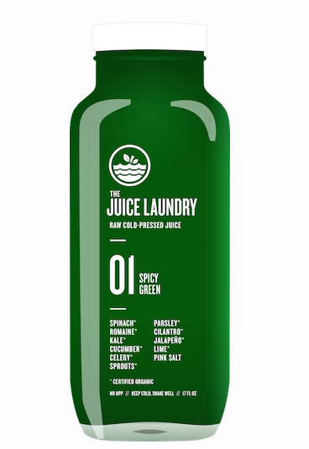
Juice Laundry’s GOMC Campaign has one primary and various secondary goals
Increase product sales
Promote juice cleansing
Tap into new customer segment
Increase brand awareness
Promote new product launch

Slide 8
17,000 impressions
263 clicks
100% ROI
1.5% clickthrough rate
$500 revenues generated
$0.95 cost per click

Slide 9
GOMC Ad Groups Categories
Events (15%)
Promote live events Juice Laundry is participating in in the Central Virginia area. No promotions in Ads. Increase events attendence, which indirectly increase sales.
Products (45%)
Advertise four categories of product Juice Laundry is currently selling. Distribution Adword exclusive coupons. This will increase sales.
Vegan (15%)
Promoting Juice Laundry to the Vegan community, reaching this new customer segment and improve sales.
Pre-summer diet (15%)
Attract customers who are searcing for summer/spring cleansing methods. Further improve sales.
Brand-awareness (10%)
Attract people who are trying to learn more about juice cleansing or cold pressed juices. Trying to educate customers about the benefit of juice cleansing. Improve brand awareness.
All Ad Groups will be geo-targeted to the Central Virginia region.

Slide 10
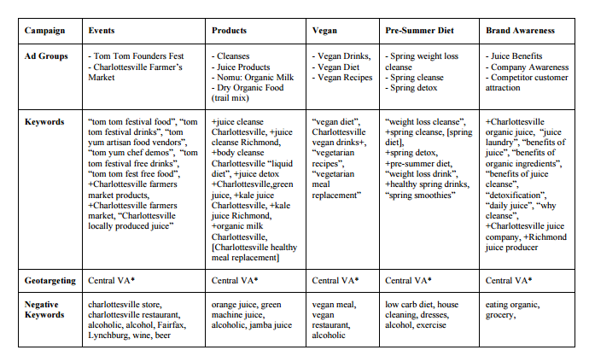

Slide 11

Ad Copy Development
Each Ad copies matches the headline with the search query with the unique value proposition on the following lines. Each ad group will have 2-3 ads and these Ads will be rotated based on metrics such as CPC and CTR. Poor performing keywords will be removed accordingly based on the CTR and CPC.
The Juice Laundry will provide two promotions to support the campaign: buy one get one free for week two and 20% discount for week three. During week one the free juice delivery feature will be advertised.

Slide 12
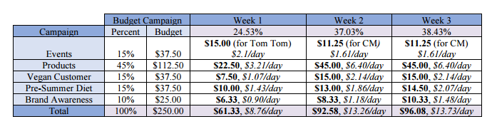
Budget Strategy
Most of the budget will be dedicated to the product Ad group category. More money will be spent on Week 2 and Week 3, where the two promotions motioned previously will be advertised.

Slide 13
Report Retrospect
3
Learn from others

Slide 14
Observations
The success of the Juice Laundry group rests on its dedication to its client’s needs and attention to details.
Very comprehensive Adgroup category analysis.
Detailed adword setup that involves in various inclusion and exclusions.
Careful balance of various client needs.

Slide 15
Thanks!
Any questions ?

